Slide 1


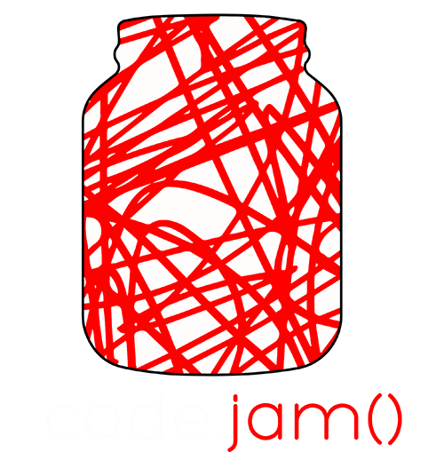

code.
jam()
proudly
presented by

Slide 4
proudly
presented by

Slide 5
code.

Slide 6
jam()

